Slide 1
The Physics of the Physics Petting Zoo

Slide 2
Various kinds of mechanical energy
Kinetic energy
Gravitational potential energy
Elastic potential energy
>> stretching spring, bending a metal strip, compressing air

Slide 3
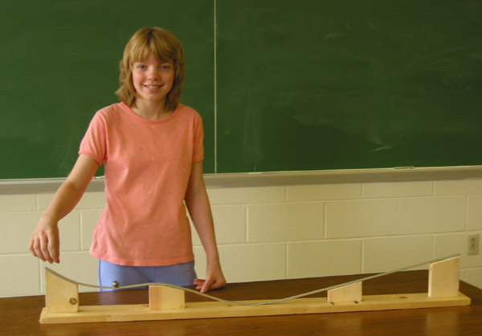
Rollercoaster

Slide 4
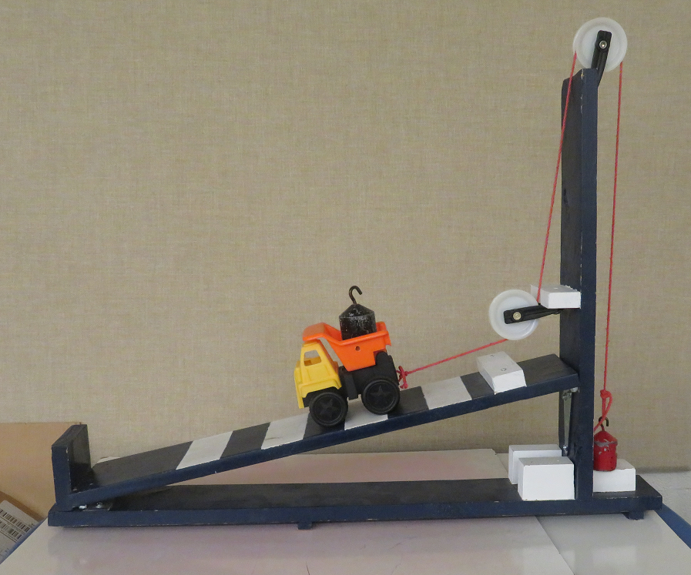
Truck on Ramp

Slide 5
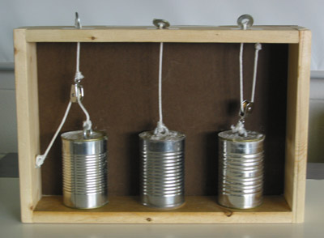
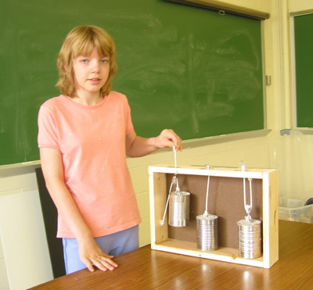

Slide 6
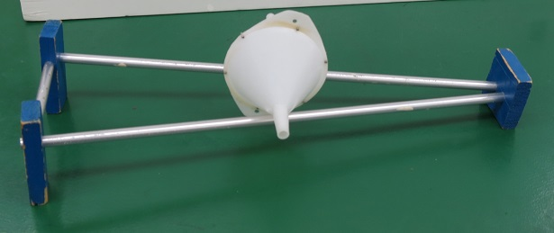
This thing rolls uphill?

Slide 7
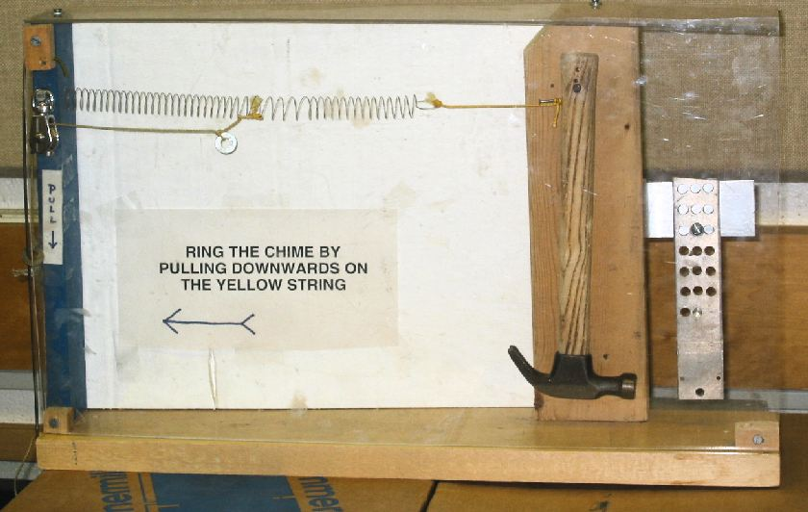
Ring the chime

Slide 8
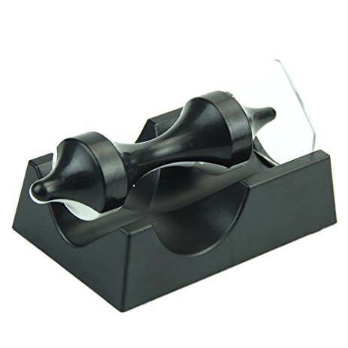
Magnetic levitation

Slide 9
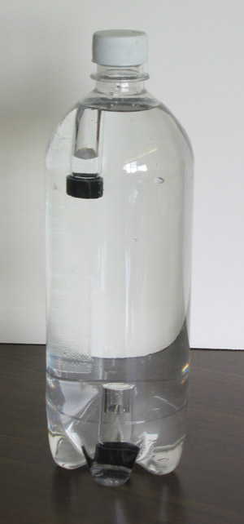
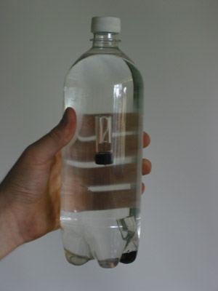
Bottle diver

Slide 10
Magnetism

Slide 11
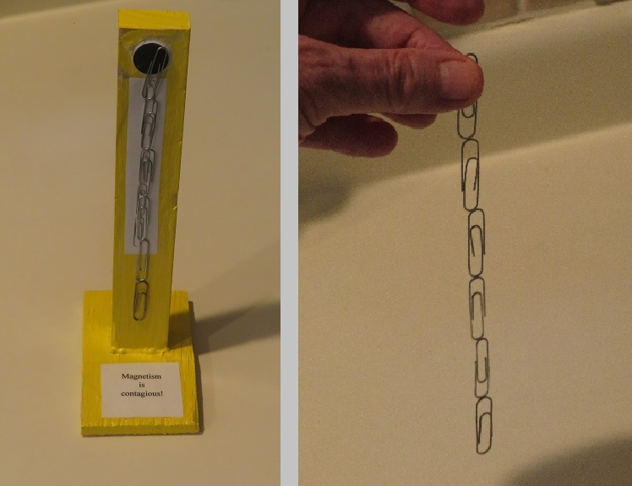
Magnetism can be contagious

Slide 12
Electromagnetism and Faraday’s law

Slide 13
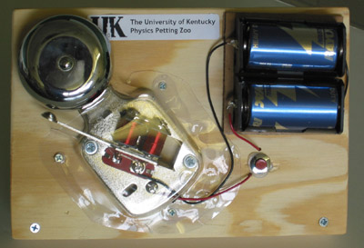
Doorbell

Slide 14
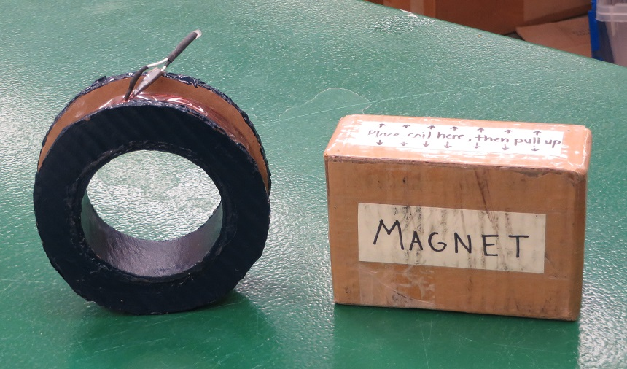
Faraday’s Law

Slide 15
Slow sliders

Slide 16
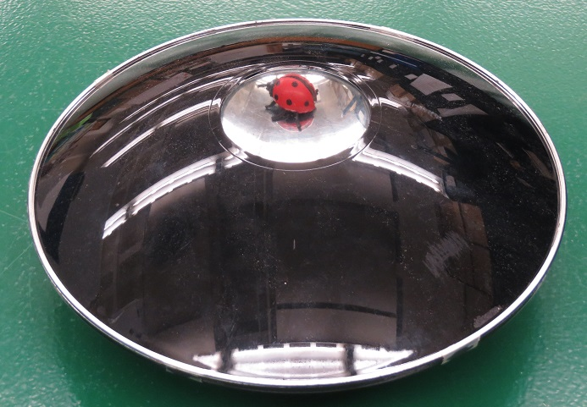
A very real image

Slide 17
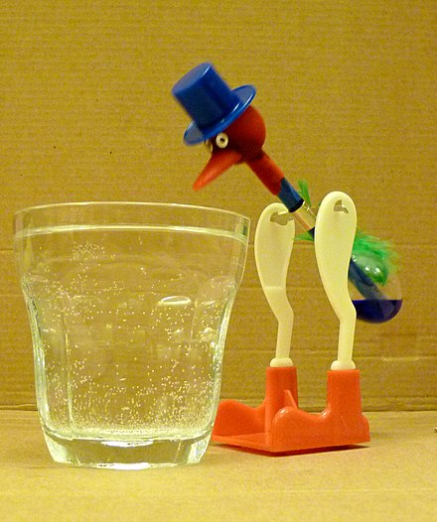
The drinking bird

